Slide 1
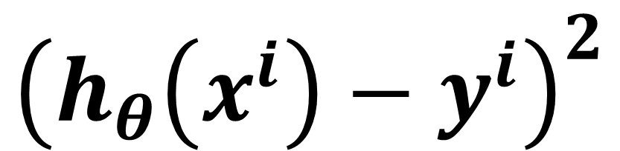
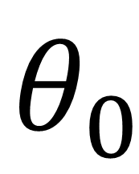
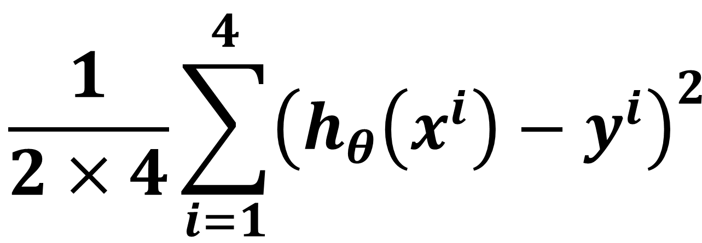
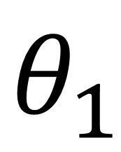
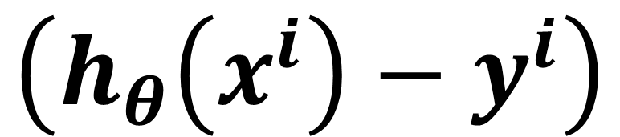
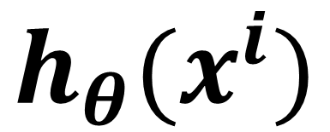
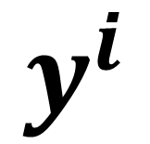
Mean Squared Error (MSE)
$$θ_{0}$$
$$θ_{1}$$
450 | 0.15
$$\frac{1}{2×4}\sum_{i=1}^{4}{{\left({h_{θ}\left(x^{i}\right)−y}^{i}\right)}^{2} }$$
$$h_{θ}(x^{i})$$
$$y^{i}$$
$$\left({h_{θ}\left(x^{i}\right)−y}^{i}\right)$$
$${\left({h_{θ}\left(x^{i}\right)−y}^{i}\right)}^{2}$$
1 | 2104
1 | 1416
1 | 1534
1 | 852
400
232
315
178

Slide 2
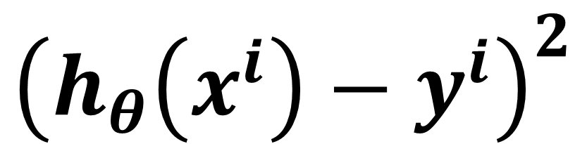
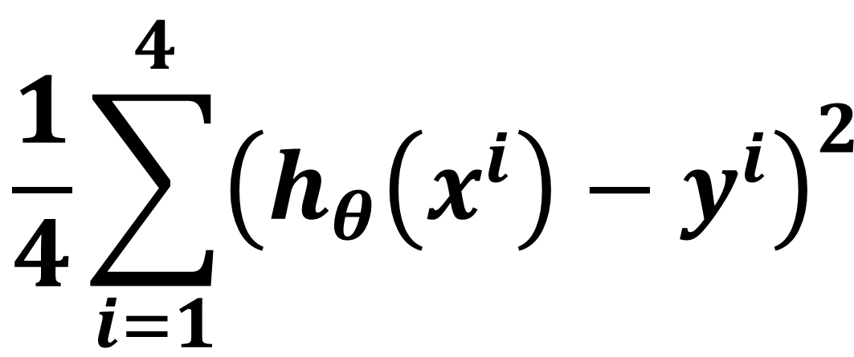
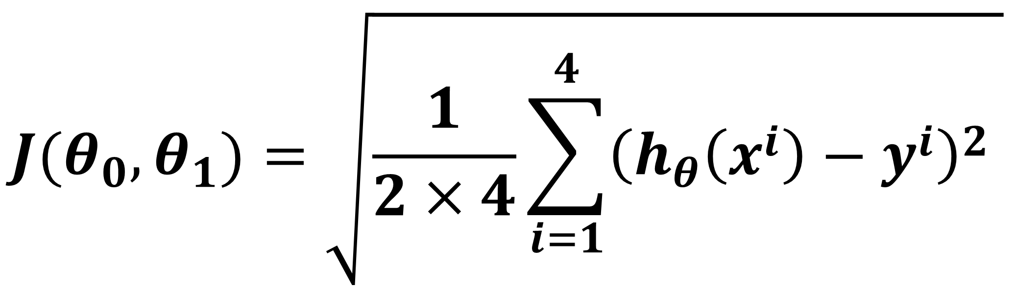
Root Mean Squared Error (RMSE)
$$θ_{0}$$
$$θ_{1}$$
450 | 0.15
$$\frac{1}{4}\sum_{i=1}^{4}{{\left({h_{θ}\left(x^{i}\right)−y}^{i}\right)}^{2} }$$
$$J(θ_{0},θ_{1})=\sqrt{\frac{1}{2×4}\sum_{i=1}^{4}{{\left({h_{θ}\left(x^{i}\right)−y}^{i}\right)}^{2} }}$$
$$h_{θ}(x^{i})$$
$$y^{i}$$
$$\left({h_{θ}\left(x^{i}\right)−y}^{i}\right)$$
$${\left({h_{θ}\left(x^{i}\right)−y}^{i}\right)}^{2}$$
1 | 2104
1 | 1416
1 | 1534
1 | 852
400
232
315
178

Slide 3
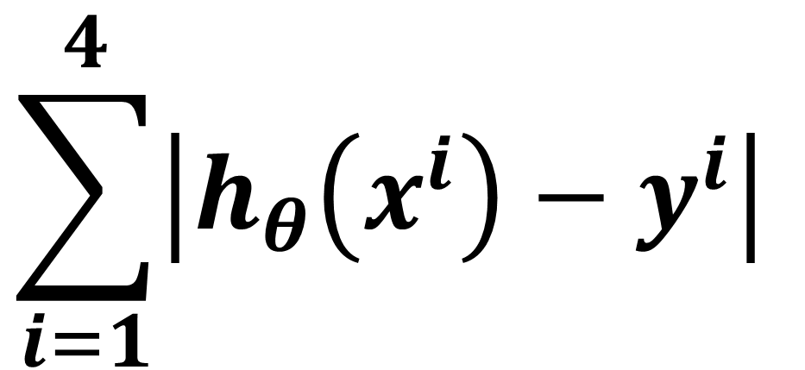
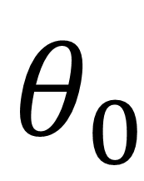
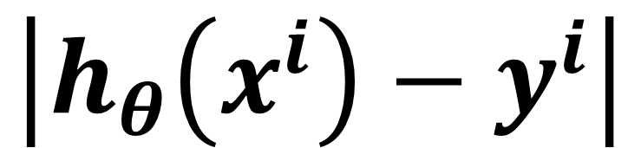
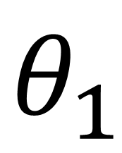
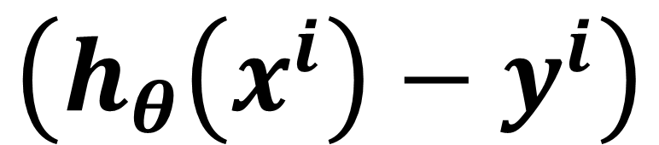
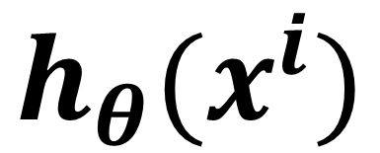
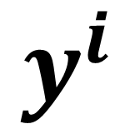
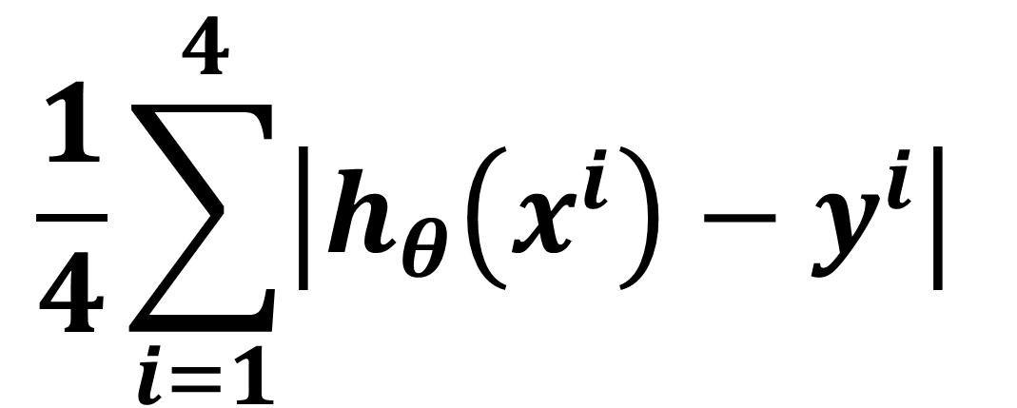
Mean Absolute Error (MAE)
$$θ_{0}$$
$$θ_{1}$$
450 | 0.15
$$\sum_{i=1}^{4}{\left|{h_{θ}\left(x^{i}\right)−y}^{i}\right| }$$
$$\frac{1}{4}\sum_{i=1}^{4}{\left|{h_{θ}\left(x^{i}\right)−y}^{i}\right| }$$
$$h_{θ}(x^{i})$$
$$y^{i}$$
$$\left({h_{θ}\left(x^{i}\right)−y}^{i}\right)$$
$$\left|{h_{θ}\left(x^{i}\right)−y}^{i}\right|$$
1 | 2104
1 | 1416
1 | 1534
1 | 852
400
232
315
178

Slide 4
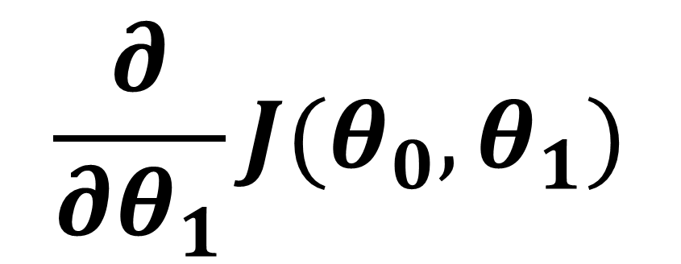
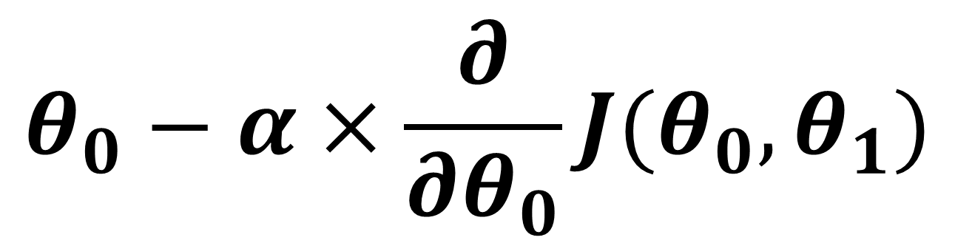
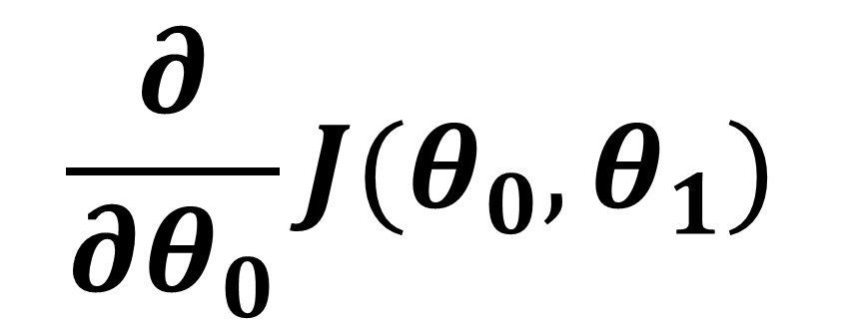
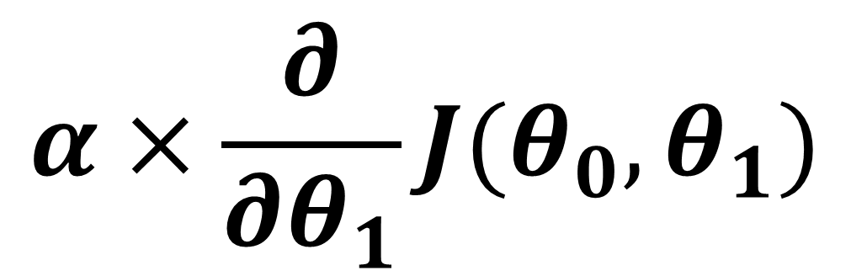
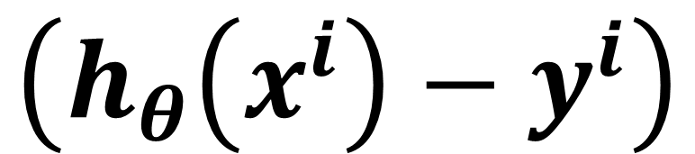
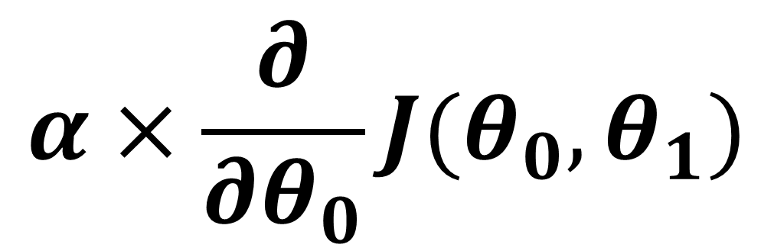
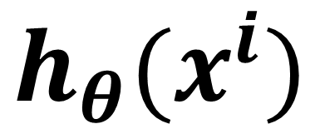
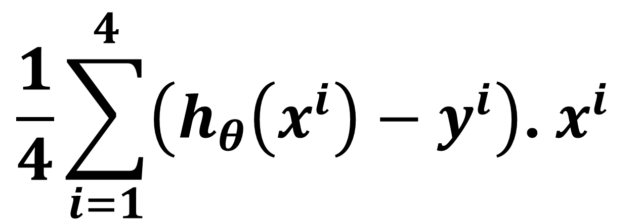
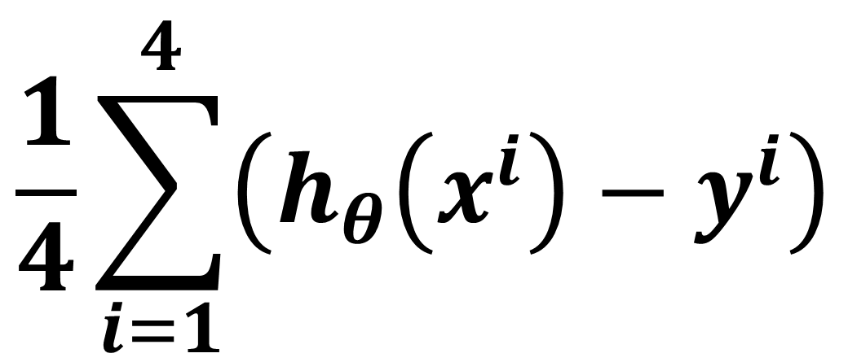
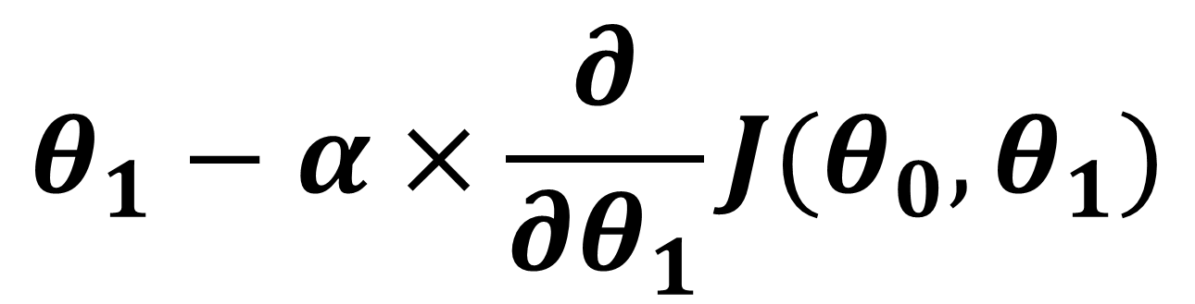
Gradient Descent – Single Iteration
$$θ_{0}$$
$$θ_{1}$$
450 | 0.15
$$\frac{∂}{∂θ_{0}}J(θ_{0},θ_{1})$$
$$\frac{∂}{∂θ_{1}}J(θ_{0},θ_{1})$$
$$\frac{1}{4}\sum_{i=1}^{4}{\left({h_{θ}\left(x^{i}\right)−y}^{i}\right)}$$
$$\frac{1}{4}\sum_{i=1}^{4}{\left({h_{θ}\left(x^{i}\right)−y}^{i}\right)\text{. }x^{i} }$$
$$α×\frac{∂}{∂θ_{0}}J(θ_{0},θ_{1})$$
$$θ_{0}−α×\frac{∂}{∂θ_{0}}J(θ_{0},θ_{1})$$
$$h_{θ}(x^{i})$$
$$y^{i}$$
$$\left({h_{θ}\left(x^{i}\right)−y}^{i}\right)$$
1 | 2104
1 | 1416
1 | 1534
1 | 852
400
232
315
178
$$α×\frac{∂}{∂θ_{1}}J(θ_{0},θ_{1})$$
$$θ_{1}−α×\frac{∂}{∂θ_{1}}J(θ_{0},θ_{1})$$

